Slide 1
Bats: Separating
Fact from Fiction

Slide 2
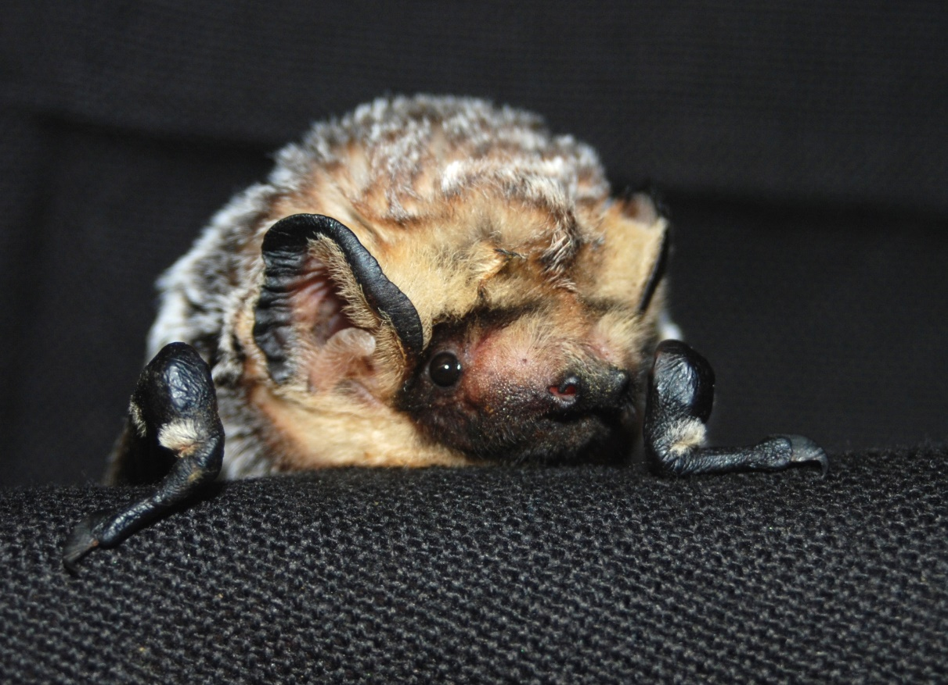
Why Bats?
Bats are the only mammals capable of powered flight
Bats represent approximately 20% of all mammal species
Bats are responsible for pollinating or protecting plants such as corn, cotton, bananas, mangos, coffee, and chocolate

Slide 3
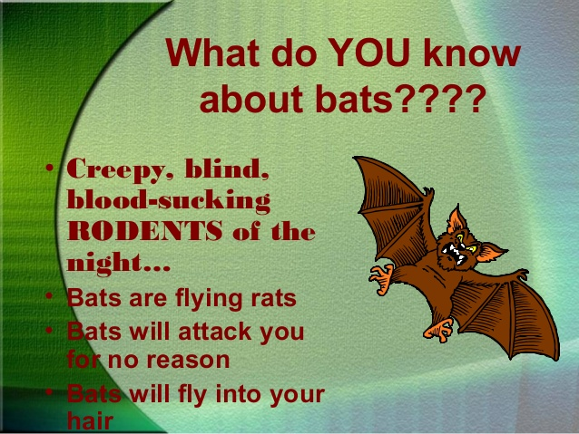

Slide 4
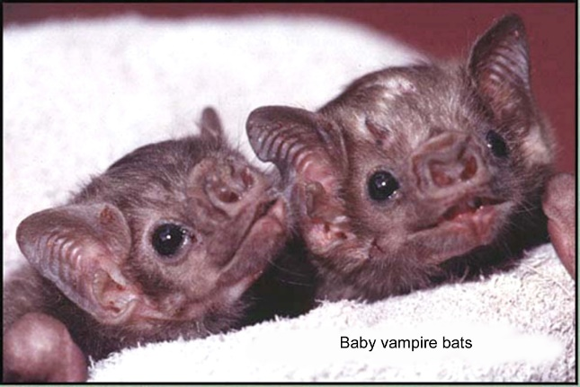
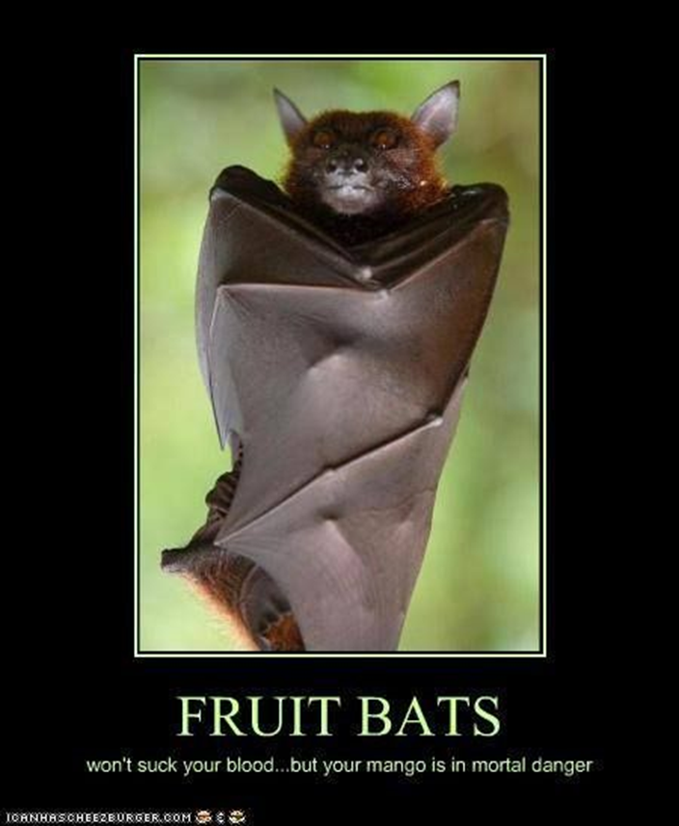
Old Wives’ Tales
Vampire bats are found in Europe, Africa, India, Asia, and North and South America
  The truth: Vampire bats are found only in Central and South America
  Of the approximately 1,400 species of bats, 70% are insect eaters and 29% are fruit and nectar feeders
  The remaining one percent of bats eat fish and frogs – this includes vampire bats as well
  There are only three species of vampire bats – common, white-winged, and hairy-legged
  Vampire bats are about the size of a hamster
Vampire bats attack people
  Of the three species of vampire bats, two (white-winged and hairy-legged) feed primarily on birds
  The other species (the common vampire bat) feed on other mammals such as cattle, goats, sheep, pigs, and monkeys, and the occasional human
    They will only feed on human blood if they cannot get anything else, and are easily scared away.

Slide 5
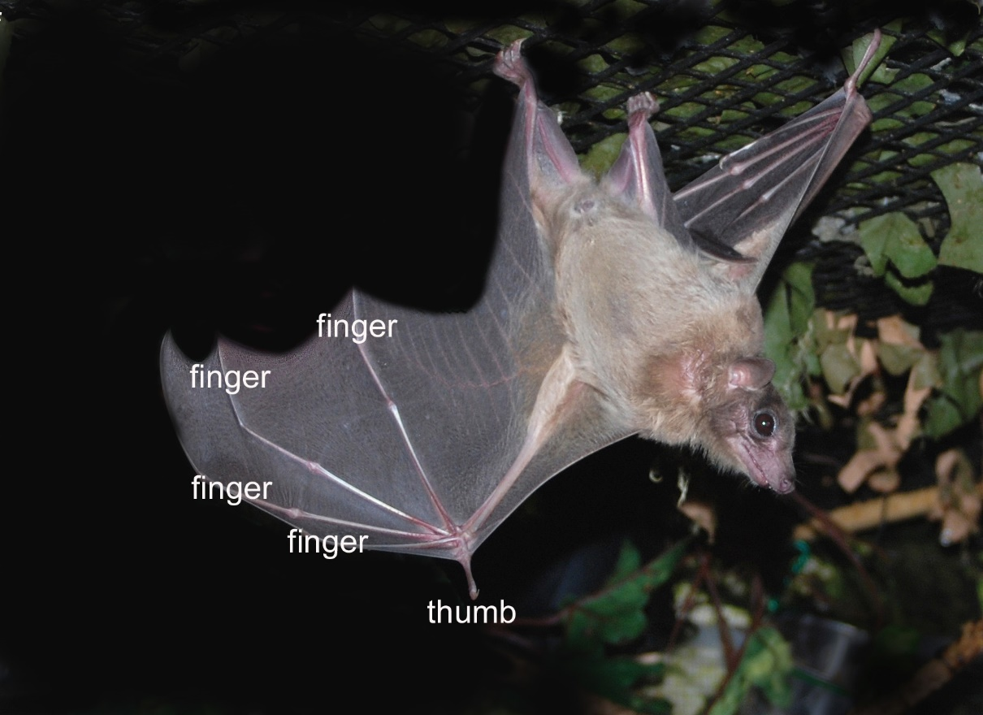
More From the Old Wives
All bats carry rabies
  Less than ½ of one percent of bats are infected with rabies
  Rabies is transmitted through direct contact between infected saliva or nerve tissue and blood or mucous membranes – a bite or scratch from an infected animal
  Being near a bat does not constitute rabies exposure
  Contact with bat fur, urine, feces, or blood does not constitute rabies exposure
  Touching an object that was touched by a bat does not constitute rabies exposure
Bats are flying mice
  Bats are no more closely related to rodents than humans are
  Bats belong to their own order, Chiroptera, which means “hand-wing”

Slide 6

Who Are These Old Wives, Anyway?
Bats are blind
  Most bats see as well as humans do
  Fruit bats see in full spectrum color
  Bats are nocturnal, and their eyesight is adapted to low light similar to cats
Bats will deliberately fly into your hair, get caught, and build nests
  Insect-eating bats use echolocation to navigate in the dark
  Using echolocation bats hunt tiny flying insects like moths in the dark, hundreds to thousands of feet up in the sky, at speeds as fast as 60mph
  Bats are such agile fliers that engineers are attempting to build helicopters and airplanes that fly the way bats do

Slide 7
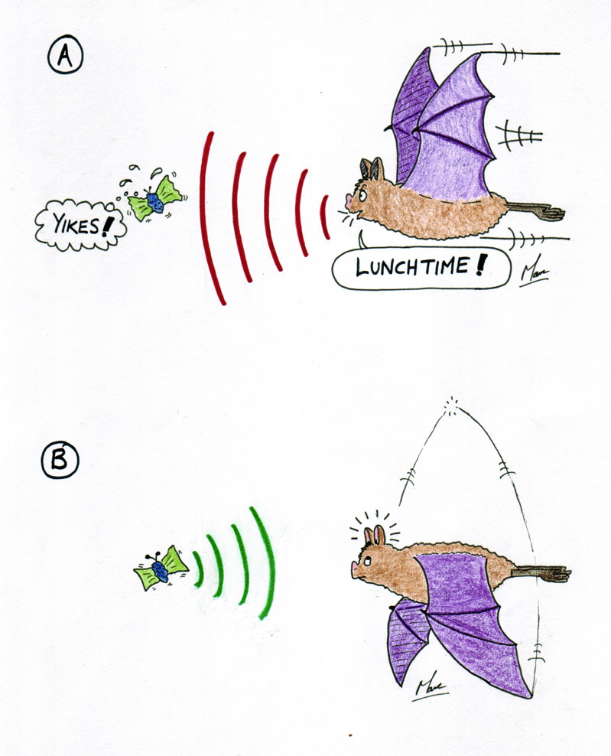
Echolocation
Echolocation is a method of using sound to locate objects
Bats use echolocation to hunt insects and avoid obstacles
The bat emits a sound (at a frequency beyond human hearing) which bounces off the target
A return signal is picked up by the bat’s ears
The bat’s brain processes the return signal in the visual cortex (they “see” sound)
As the target gets closer the signals bounce back more rapidly

Slide 8
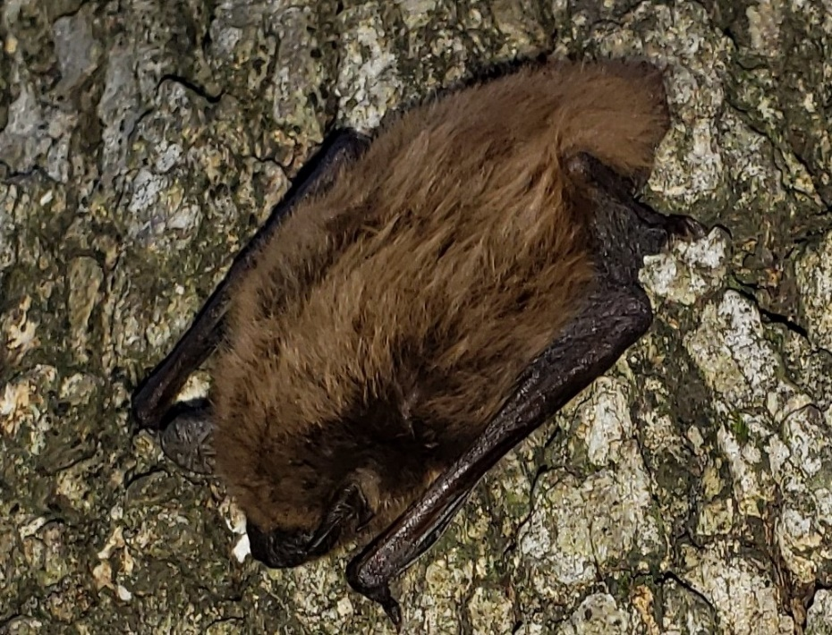
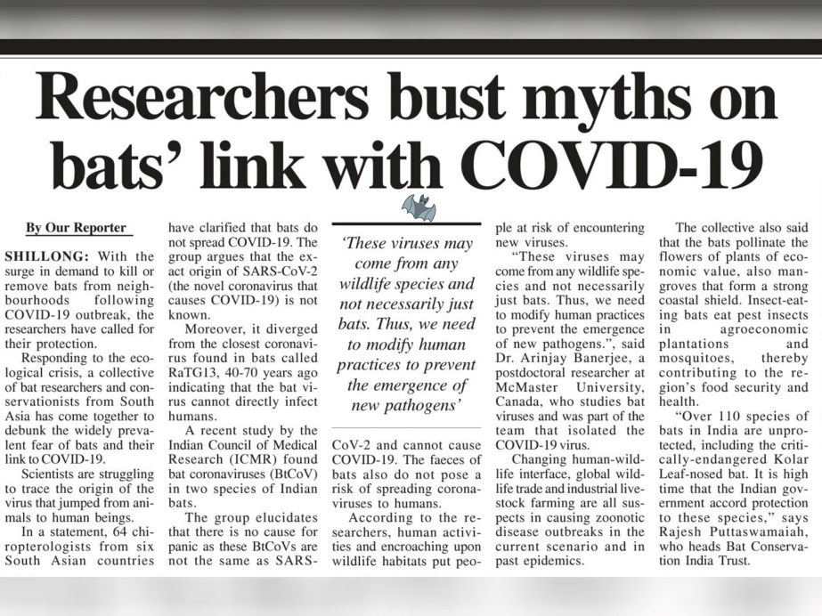
Bats and COVID-19
Many people are afraid of contracting COVID-19 from bats
  In Peru, people destroyed bat colonies out of fear
  SARS-CoV2 is not found in South American bat species
  In North America, research involving bats, and bat rehabilitation, were suspended out of fear
  There is no evidence that North American bats are susceptible to COVID-19 or will become a new reservoir for SARS-CoV2

Slide 9
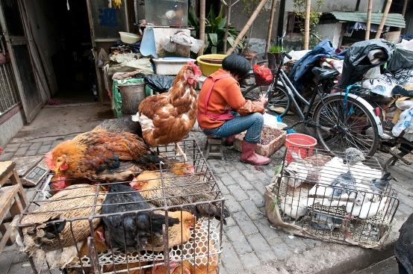
Where did SARS-CoV2 come from?
Research has shown that the SARS-CoV2 virus most likely originated in the Asian Horseshoe bat, 40-70 years ago
Bats were sold as a delicacy at an Asian live market in Wuhan, China
The bats were housed in close proximity to other live wild and domestic animals

Slide 10
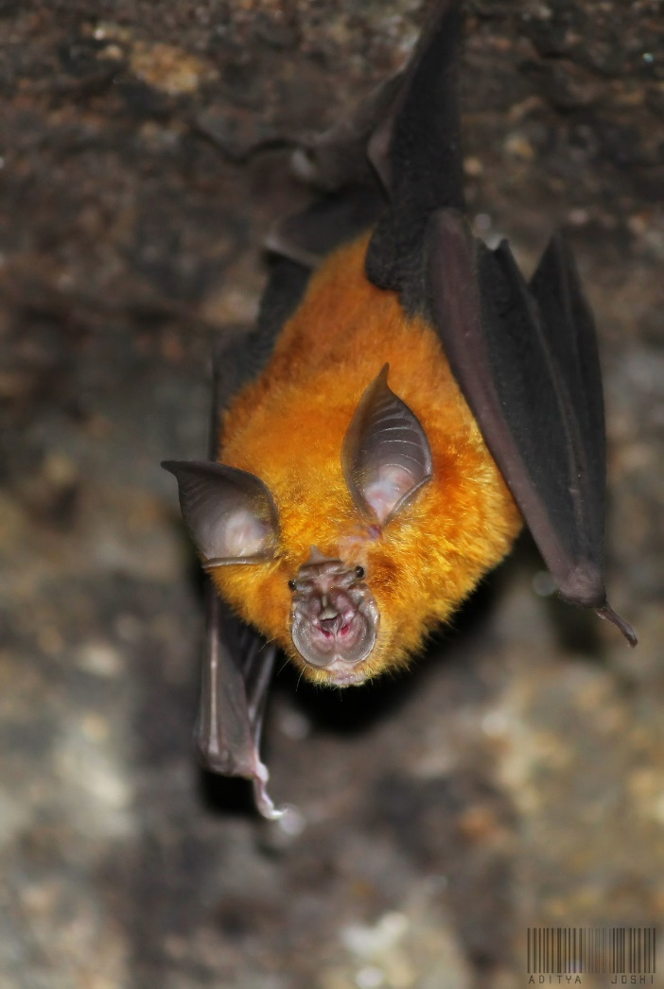
Meet the Asian Horseshoe Bat
The Asian or Rufous Horseshoe Bat is a medium-sized insectivorous bat
This species is common to China, India, Nepal, and Viet Nam
Rufous Horseshoe bats are considered a delicacy in parts of Asia
Like many wildlife species, bats may also be used in traditional medicinal remedies

Slide 11
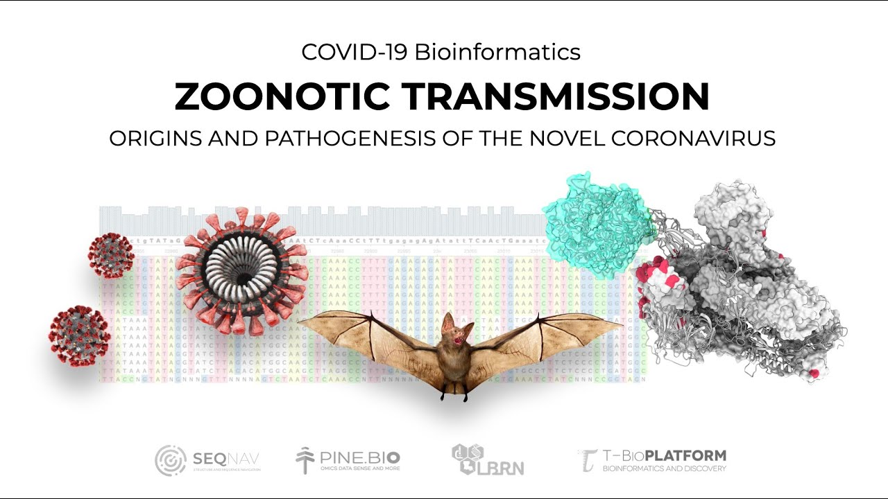
How Did SARS-CoV2 Infect Humans?
Direct transmission of viral pathogens from bats to humans is rare
The intermediate species in the COVID-19 outbreak has not yet been identified
Introduction of a new virus into humans is called a “spillover”
As we continue to interfere with wild animals and their habitats we increase our risk of disease

Slide 12
Separating Fact From Fiction
Fact: Bats harbor a number of viruses
Fiction: Bats transmit viruses directly to humans
Fact: One or more other, unrelated species are involved in virus transmission
Fiction: North American bats carry SARS-CoV2
Fact: Human contact with wildlife increases our risk of exposure to new viruses
Fiction: Wild animals are to blame for human viral infections
Fact: Wild animals do not seek out contact with humans

Slide 13

What About Bats and Rabies?
Based on extensive research, the CDC estimates that less than one-half of one percent of all bats is infected with rabies
Bats do not “carry” rabies
Rabies exposure requires direct contact between infectious saliva or nerve tissue and blood or mucous membranes – i.e. a bite or scratch from an infected animal that is shedding the virus

Slide 14
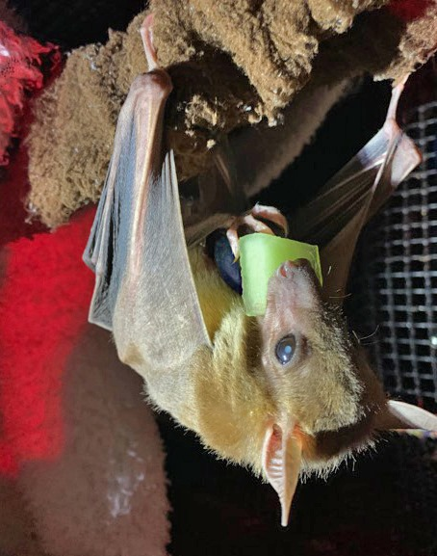
You can’t get rabies from…..
You cannot get rabies from a piece of fruit that was licked by a bat
You cannot get rabies from a bat flying near you
You cannot get rabies from touching an object that may have been touched by a bat
You cannot get rabies from bat urine, guano, blood, or fur
You cannot get rabies from a water source where a bat took a drink

Slide 15
Protect People, Protect Bats!
https://youtu.be/O0IUxHkbXzI

Slide 16


Disappointing, but….
Bats are not portents of death
Bat guano will not make you crazy
Mascara and eyeliner are not made from bat guano
Bat Boy isn’t real
Bats don’t lay eggs
The real “Count Dracula” did not turn into a bat

Slide 17
What Do You Know About Bats Now?

Slide 18
For more information about
how bats make our world
a better place, visit
www.batworld.org

